Slide 1
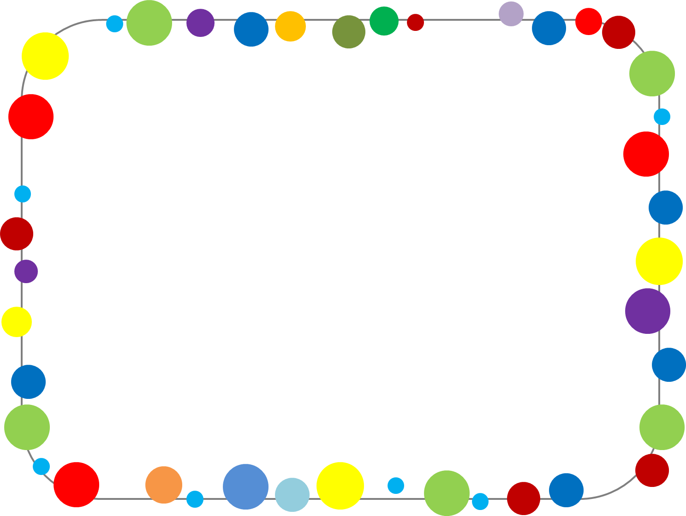
Picture Dictionary
Student’s Photo
Name:____________

Slide 2
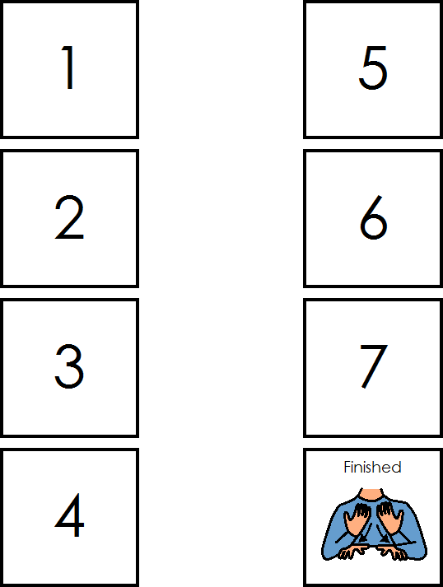


Slide 3

A a

Slide 4

B b

Slide 5

C c

Slide 6

D d

Slide 7
E e

Slide 8
F f

Slide 9
G g

Slide 10
H h

Slide 11
I i

Slide 12
J j

Slide 13
K k

Slide 14
L l

Slide 15
M m

Slide 16
N n

Slide 17
O o

Slide 18
P p

Slide 19
Q q

Slide 20
R r

Slide 21
S s

Slide 22
T t

Slide 23
U u

Slide 24
V v

Slide 25
W w

Slide 26
X x

Slide 27
Y y

Slide 28
Z z

Slide 29
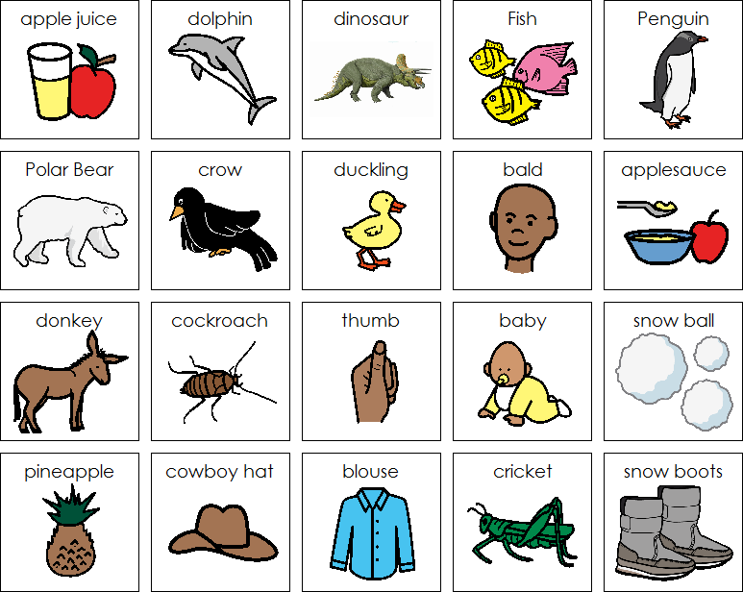

Slide 30
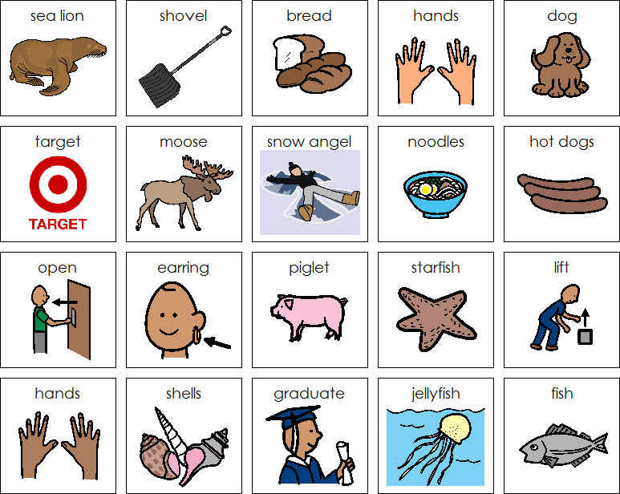

Slide 31
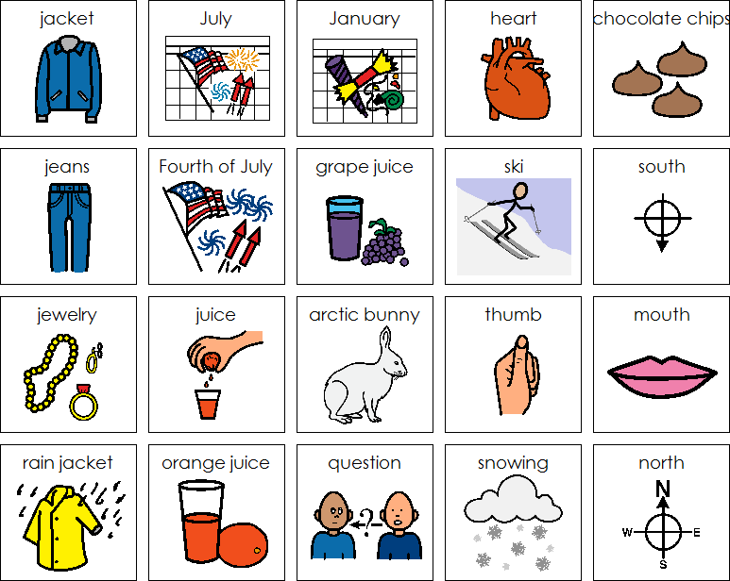

Slide 32
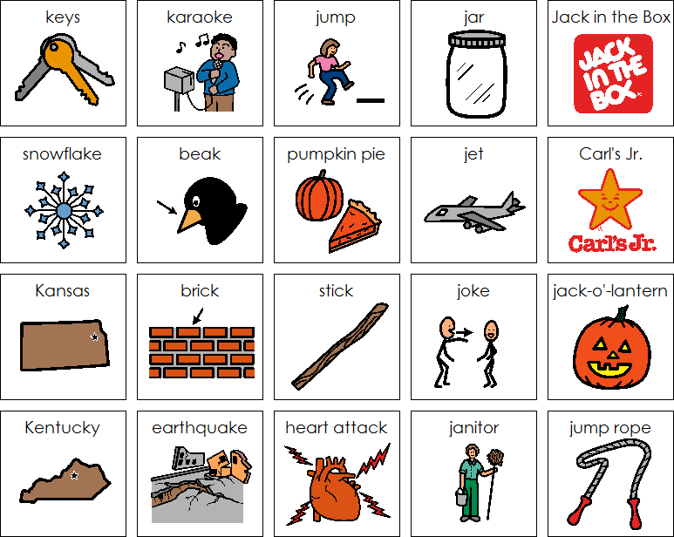

Slide 33
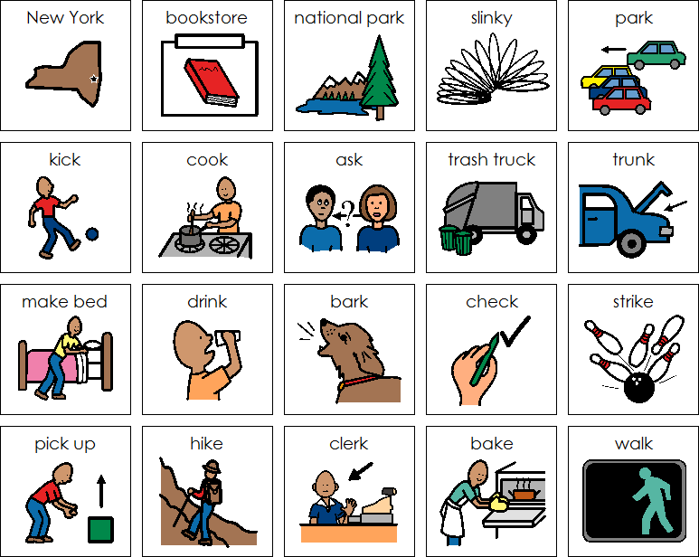

Slide 34
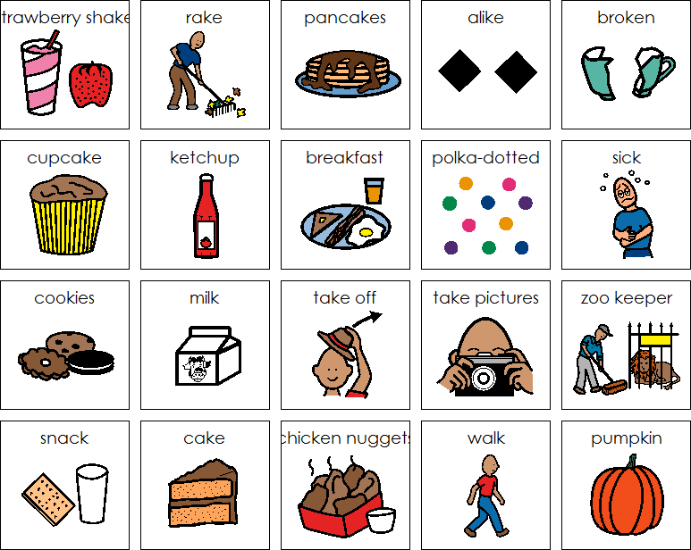

Slide 35
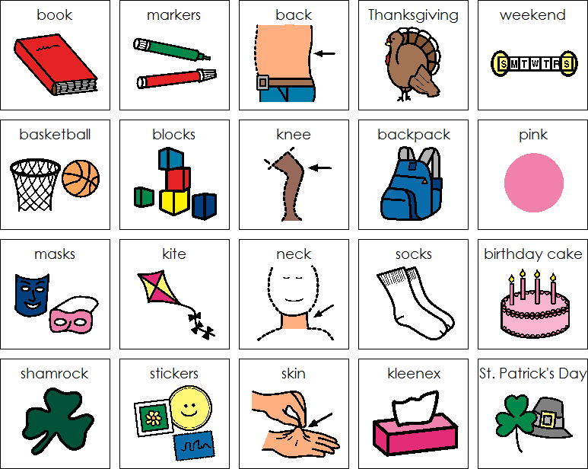

Slide 36
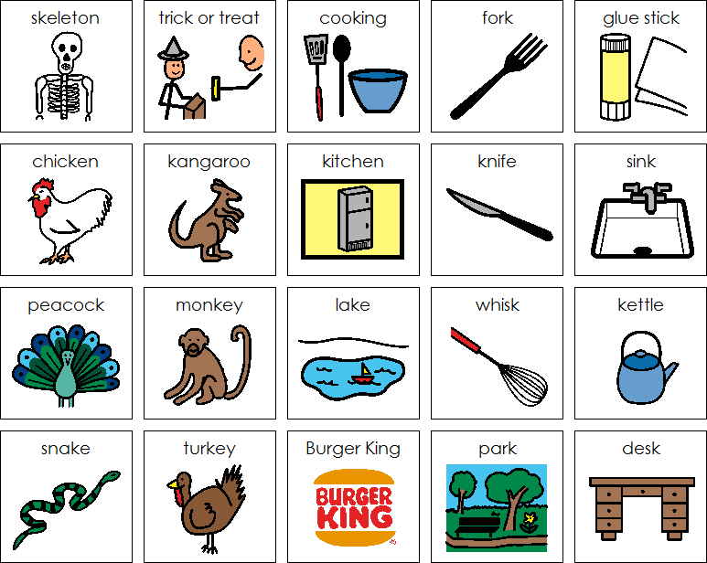

Slide 37
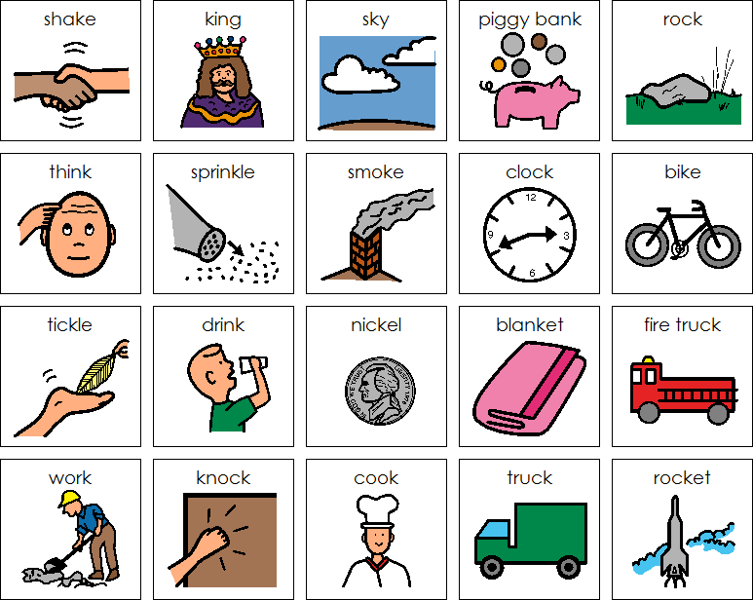

Slide 38

All finished!

